Slide 1




Data Standards and Data Fields
Pam Soltis
University of Florida
BiotaPhy

Slide 2
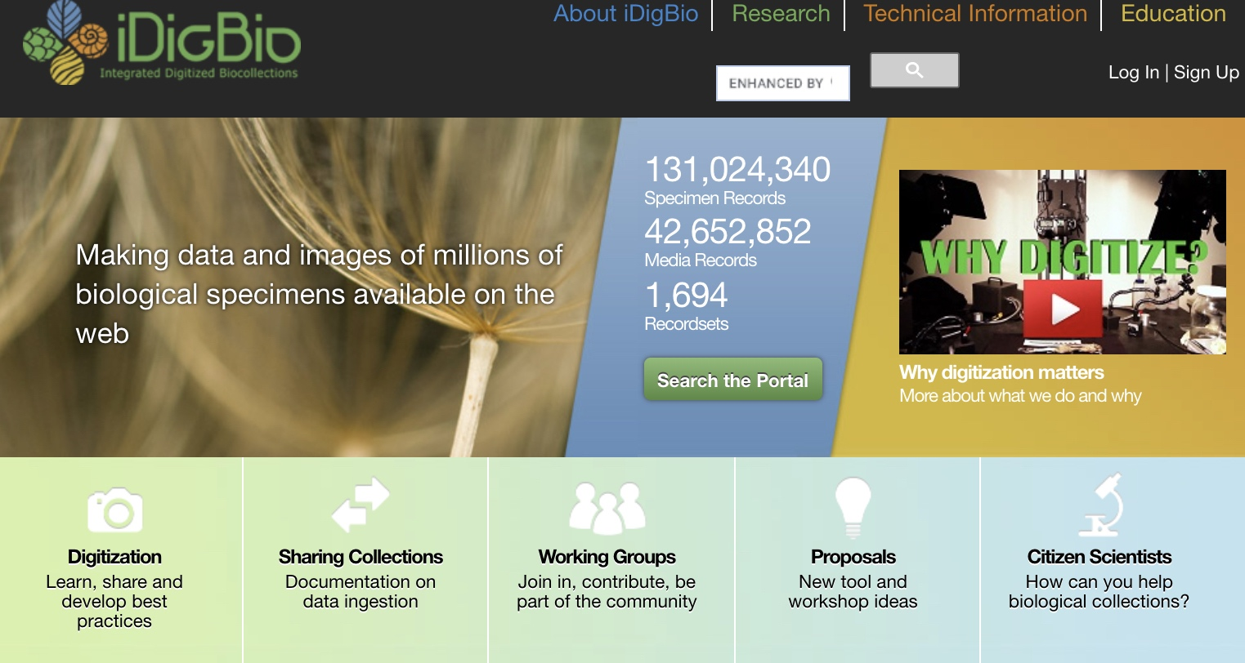
iDigBio: A Source for Specimen Records

Slide 3
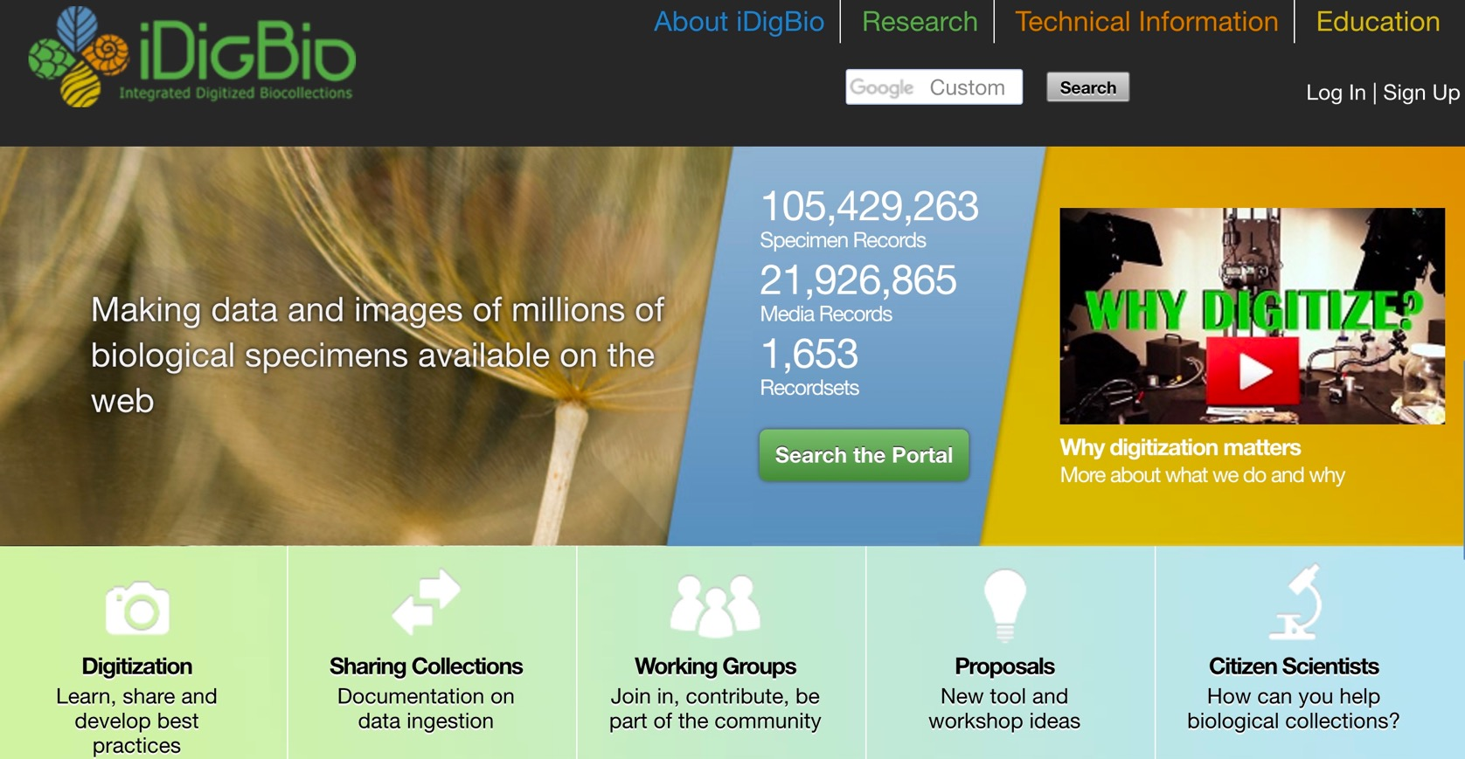
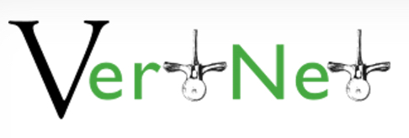
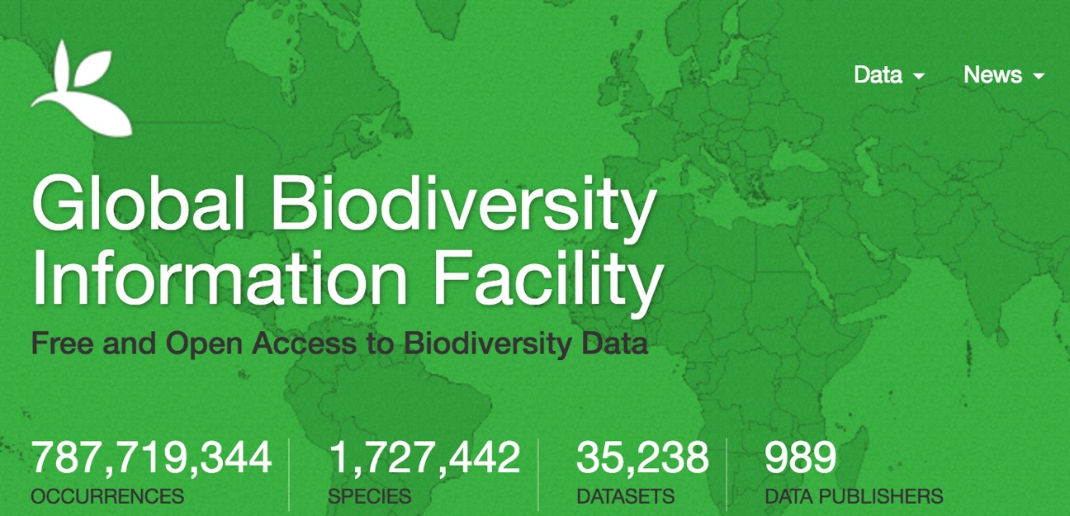


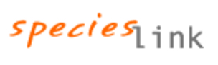
Other Data Aggregators
Notes:
iDB is referred to as a specimen aggregator – and there are other specimen data aggregators, such as those shown here, so that there is a global network of specimen data.

Slide 4
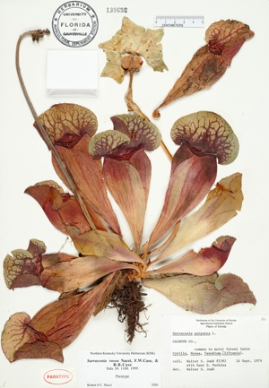
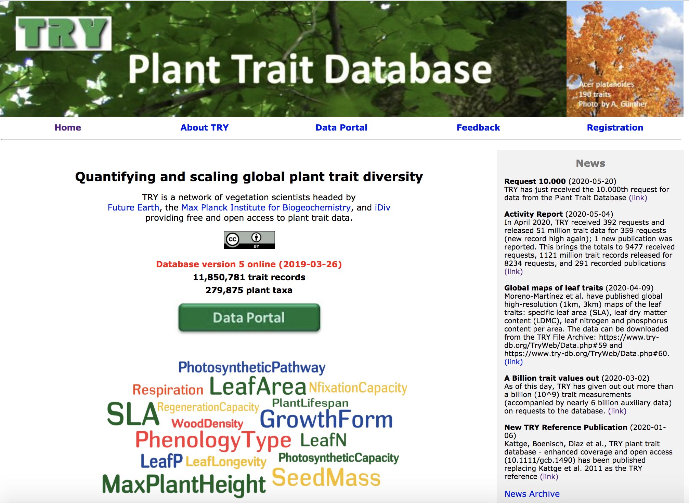



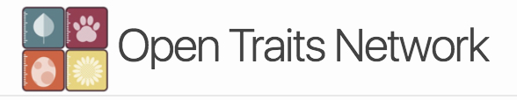





Repositories
Repositories

Slide 5
Standards
Standards

Slide 6
Standards
Standards – ‘Adapters’

Slide 7
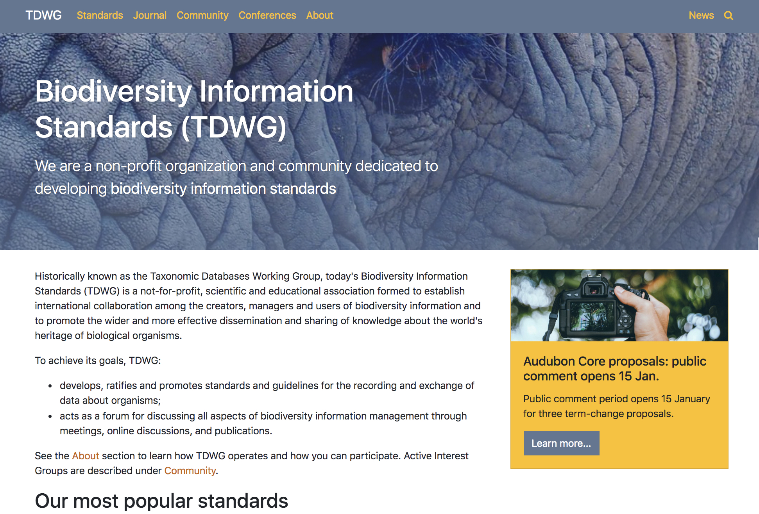
Standards – tdwg.org

Slide 8
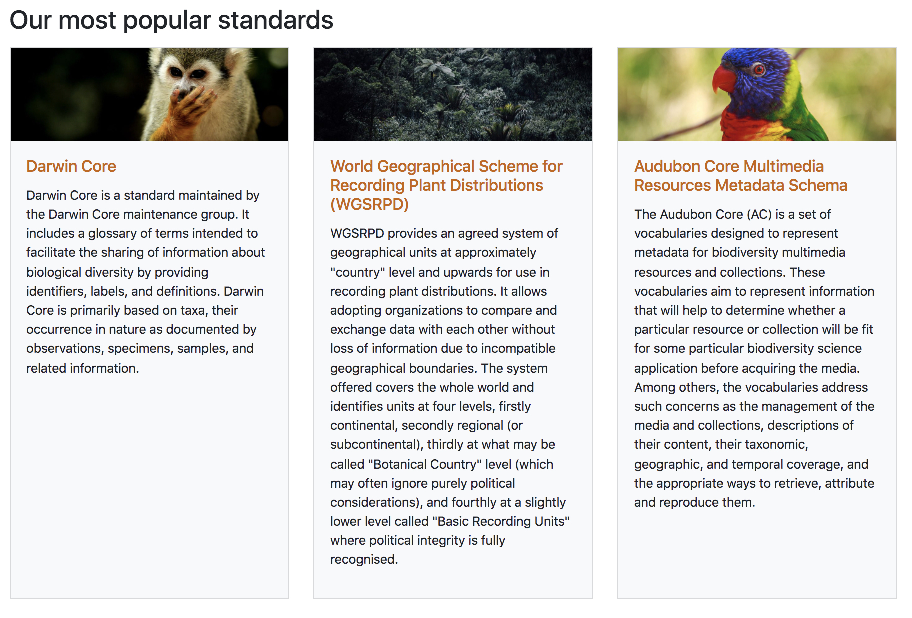
Standards – tdwg.org

Slide 9
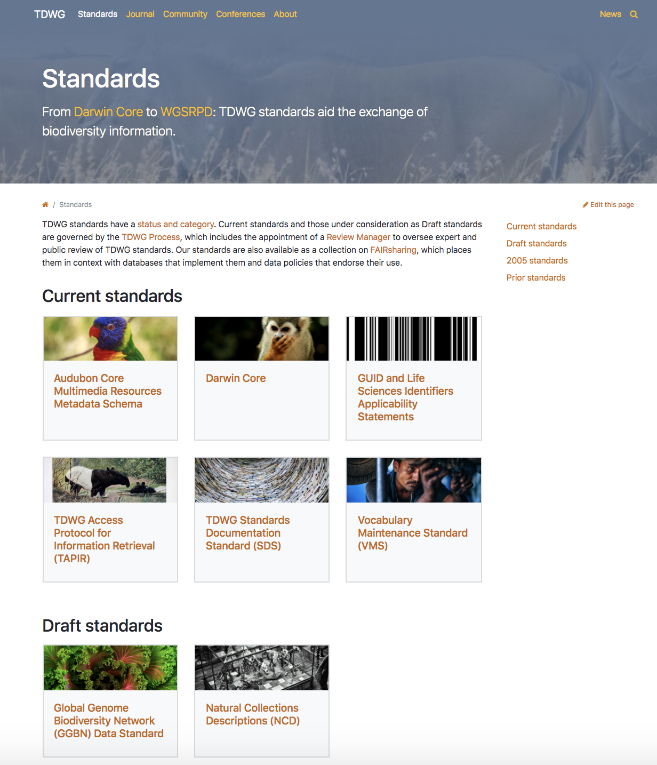
Standards – tdwg.org

Slide 10
Standards: Darwin Core
Standards: Darwin Core
species name
collector name
date of collection
location of collection – country, state, county, latitude, longitude
etc.

Slide 11
Standards: Audubon Core
Standards: Audubon Core
vocabularies for multimedia resources for biodiversity
videos
photographs
audio recordings
etc.

Slide 12
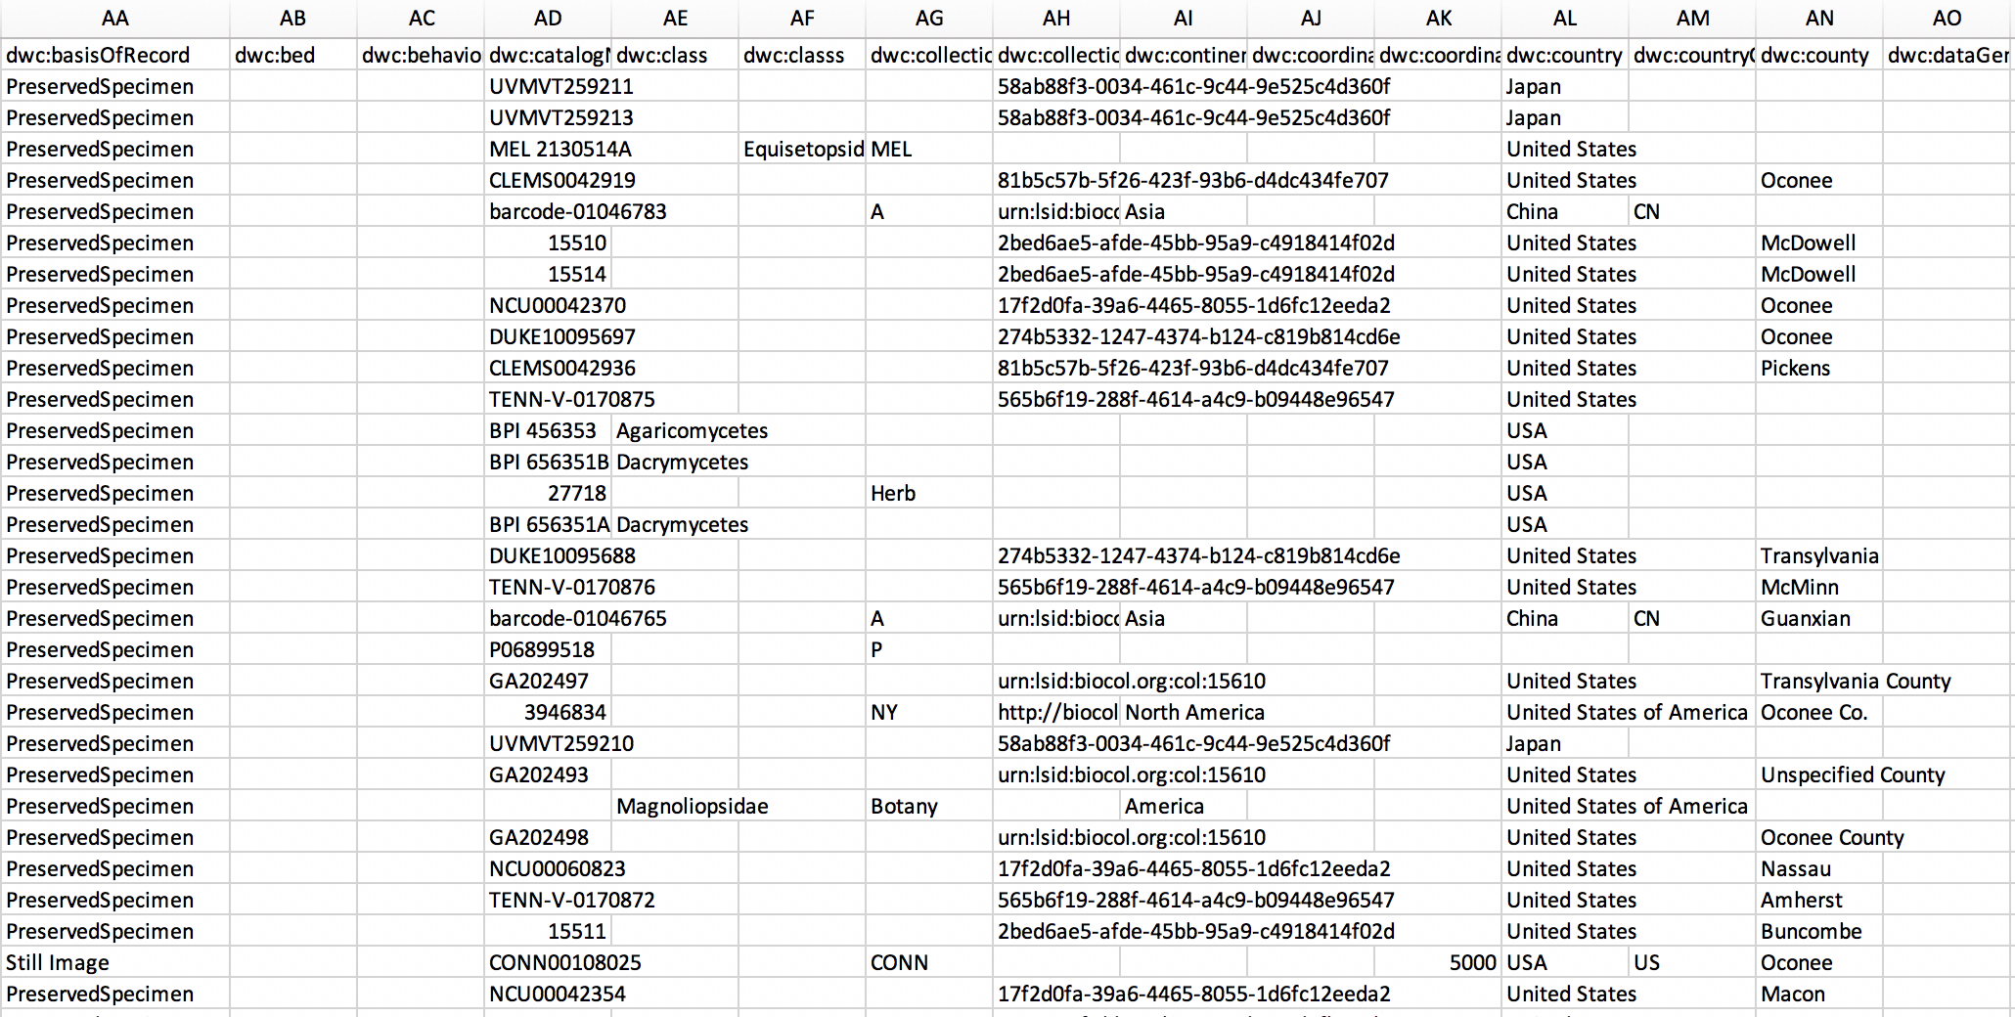
Standards: Darwin Core

